Slide 1

Environmental Health and Safety
Nate Siladke, Ph.D.
Director of Research Safety/Chemical Hygiene Officer
nsiladke@caltech.edu
626.395.6727

Slide 2
Safety Is Everyone’s Responsibility
Make safety a part of your research
Ensures safe working environment
You
Your Faculty
Caltech
Your Co-Workers
Provide training, assessments, inspections
Participate in keeping lab safe
Notes:
Everyone plays a role in the Safety Culture at Caltech.
Being engaged through discussion, improving safety, and receiving training all contributes to the overall safety in your lab.
Since lab work is typically independent, a safe lab starts with You!

Slide 3


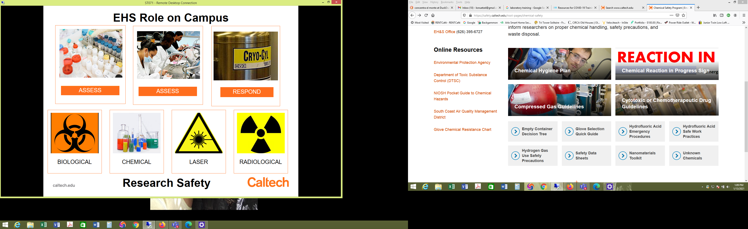
Research Safety
Environmental Health and Safety
Management of design services w iterative reviews
Facilitate project permitting and other approvals
Validate budget and schedules
Biological
Chemical
Laser
Radiological
EHS provides written Programs and supporting information for each research safety discipline, which are available on the EHS website

Slide 4
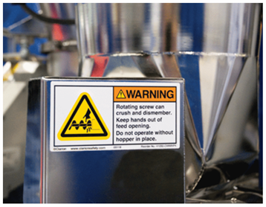
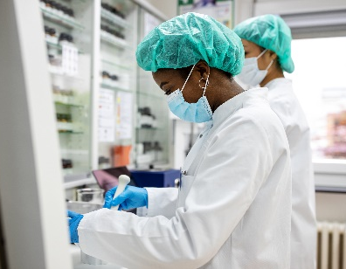
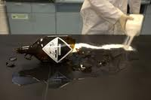
EHS Support to Campus
Environmental Health and Safety
Management of design services w iterative reviews
Facilitate project permitting and other approvals
Validate budget and schedules
Respond to Incidents
Assess Hazards
Train Personnel
Notes:
EHS overall role is to support safe science.

Slide 5

ASSISTANCE WITH SOPs

Slide 6
Required Training from Safety Office
Find Training Matrix on EHS Website → Training tab
EHS offers additional trainings
Postdocs working in wet labs need Lab Safety Orientation
Notes:
To determine what training is needed from the Safety Office, please refer to the Training Requirements for Researchers Matrix.
You are currently taking Lab Safety Orientation, which is required and is listed on this Matrix
The hazards you are working with in the lab will dictate which training(s) you will need.
This matrix is available on the Safety website.

Slide 7

INCIDENT REPORTING & INJURY RESPONSE
IMMEDIATELY REPORT ANY KIND / ANY TIME
CALL x5000 (campus phone) or 626-395-5000*
*ADD THIS NUMBER TO YOUR CELL PHONE-Caltech Security
EHS Response to Incidents
Notes:
Report any injury or safety incident by calling x5000 from a campus phone or 626-395-5000 from your cell phone anytime, 24 hours a day, 365 days a year. We encourage everyone to put the phone number in their cell phones for easy access
When calling x5000, be prepared to provide some basic information to the dispatcher
Also remember to inform your supervisor after reporting to x5000

Slide 8
Additional Resources
Ergonomic Evaluations
Hazardous Waste
Shipping of hazardous materials (chemical, biological, radiological, batteries)
Other resources available on EHS website: safety@caltech.edu

Slide 9

We Want to Help You Stay Safe!
Environmental Health and Safety
(626) 395-6727
Keith Spalding
M-F 8am-5pm + 24/7 on-call
www.safety.caltech.edu safety@caltech.edu
Safety.Training@caltech.edu

